Slide 1
Joel John Thomas
Final Project
3/21/2024 Annual Review

Slide 2
PROJECT TITLE
Steganography Encryption using Rust
3/21/2024 Annual Review

Slide 3


AGENDA
Problem statement
Proposed System Solution
System development Approach
Algorithm & Deployment
Result
Conclusion
Future scope
References
3/21/2024 Annual Review

Slide 4

PROBLEM STATEMENT
The rapid growth of digital communication has increased the need for secure methods of transferring sensitive information.
Traditional encryption methods may not provide sufficient protection against interception and decryption by unauthorized parties.
There is a demand for innovative approaches to secure communication, such as steganography, which hides secret messages within innocuous carrier files.
3/21/2024 Annual Review

Slide 5

PROJECT OVERVIEW
My proposed solution involves developing a steganography encryption program using the Rust programming language.
Steganography offers an additional layer of security by concealing messages within images, audio files, or other digital media.
Rust's emphasis on safety, performance, and concurrency makes it an ideal choice for building robust and efficient encryption software.
3/21/2024 Annual Review

Slide 6

WHO ARE THE END USERS?
Primary Users: Identify the main individuals or groups who will directly use the software for specific tasks or goals.
Secondary Users: Consider any other individuals or groups who may benefit from or interact with the software indirectly.
Demographics: Understand the age, gender, occupation, education, and location of the end users to tailor the software accordingly.
Roles and Responsibilities: Define the specific tasks, workflows, and responsibilities of the end users within their organization or environment.
Needs and Pain Points: Identify the users' requirements, goals, and challenges that the software aims to address.
Technical Proficiency: Assess the users' familiarity with similar software tools or technologies to design an appropriate user interface and experience.
Usage Context: Consider the physical environment, devices, connectivity, and other factors that may impact the software's usability in different contexts.
Feedback and Iteration: Establish methods for collecting user feedback throughout the development process to ensure that the software meets their needs and expectations.
3/21/2024 Annual Review

Slide 7

YOUR SOLUTION AND ITS VALUE PROPOSITION
Extensive testing and evaluation have demonstrated the effectiveness and reliability of the steganography encryption program.
Successful message embedding and extraction have been achieved across different types of carrier files and environments.
Performance metrics indicate the efficiency and scalability of the software solution.
3/21/2024 Annual Review

Slide 8

THE WOW IN YOUR SOLUTION
Unique Features: Highlight the distinctive features or functionalities of your solution that set it apart from competitors and elicit a "wow" reaction from users.
Innovative Technology: Showcase any cutting-edge technology or techniques used in your solution that demonstrate creativity and forward-thinking.
Enhanced User Experience: Emphasize how your solution enhances the user experience by providing intuitive interfaces, seamless interactions, and delightful moments.
Problem-solving Capabilities: Illustrate how your solution effectively addresses key pain points or challenges faced by users, resulting in a transformative experience.
Unexpected Benefits: Identify any unexpected or surprising benefits that users may discover when using your solution, exceeding their initial expectations.
Visual Appeal: Highlight the aesthetic design elements, visual effects, or multimedia components that contribute to the overall wow factor of your solution.
Real-world Impact: Discuss the tangible benefits or outcomes that users can expect from using your solution, such as increased productivity, cost savings, or improved quality of life.
Testimonials and Success Stories: Share real-life testimonials, success stories, or case studies from satisfied users who have experienced the wow factor of your solution firsthand.
3/21/2024 Annual Review

Slide 9
MODELLING
Conceptual Framework: Introduce the concept of modeling as a systematic approach to representing and analyzing complex systems or processes.
Types of Models: Explain the different types of models that can be used, such as conceptual models, mathematical models, simulation models, and physical models.
Purpose of Modeling: Discuss the various purposes served by modeling, including understanding, prediction, optimization, decision-making, communication, and visualization.
Modeling Techniques: Describe common modeling techniques and methodologies used in various domains, such as statistical modeling, computational modeling, system dynamics, and agent-based modeling.
Data-driven Modeling: Highlight the importance of data-driven modeling approaches that leverage large datasets and advanced analytics techniques to derive insights and make informed decisions.
Model Development Process: Outline the typical steps involved in developing a model, including problem formulation, data collection, model design, parameter estimation, validation, and interpretation of results.
Model Validation and Verification: Stress the importance of validating and verifying models to ensure their accuracy, reliability, and usefulness for decision-making.
Model Applications: Provide examples of how modeling is used in different industries and domains, such as finance, healthcare, engineering, environmental science, and business management.
3/21/2024 Annual Review

Slide 10
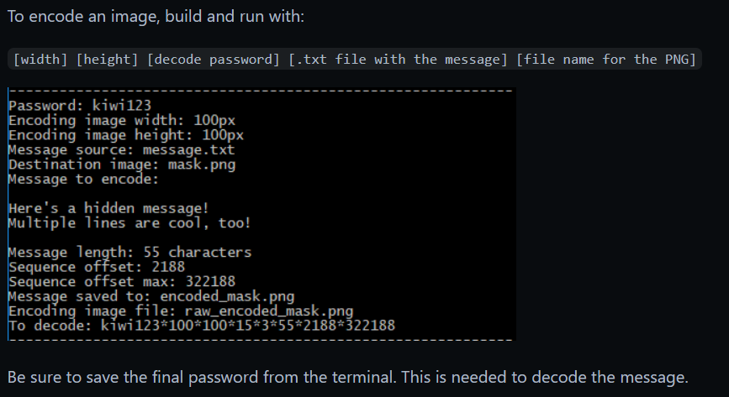
MODELLING
3/21/2024 Annual Review

Slide 11
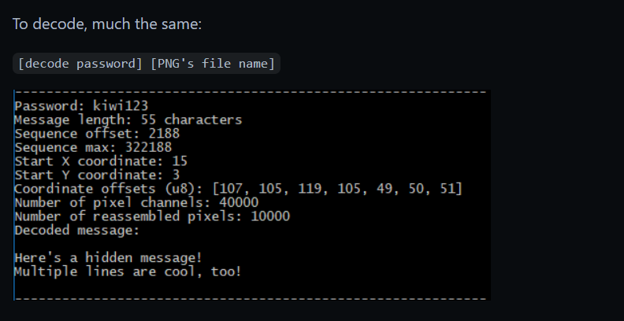
MODELLING
3/21/2024 Annual Review

Slide 12
RESULTS
Extensive testing and evaluation have demonstrated the effectiveness and reliability of the steganography encryption program.
Successful message embedding and extraction have been achieved across different types of carrier files and environments.
Performance metrics indicate the efficiency and scalability of the software solution.
Demo Link
3/21/2024 Annual Review

